Slide 1
Introduction to app model transition
Name
Title
Company

Slide 2
Agenda
Introduction
Transition process
App model principles
Customization considerations
Notes:
Introduction to app model and transformation
Technical introduction
Why not farm solutions (full trust code) or sandbox solutions?
Recommendations for app model implementations
Process and approach
What to consider in existing farm solutions
If you still write farm solutions, what should you consider to make future transformation easier?

Slide 3
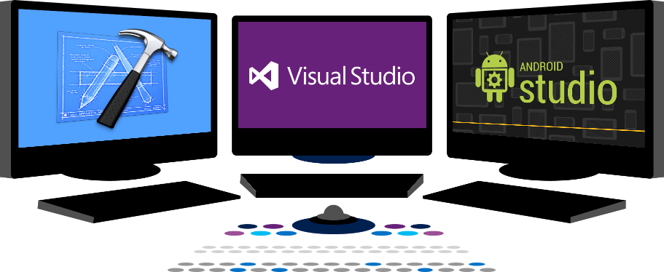














Vision
EXTEND OFFICE EVERYWHERE
CONNECT TO OFFICE 365 SERVICES
BUILD USING AN OPEN PLATFORM
Delve
z
Users and groups
Files
Mail
Calendar
My Apps
Video Portal
Contacts
Office Graph
Presentations
Documents
Spreadsheets
Lync
OneNote
Yammer

Slide 4
Recommendations
Align with service and product roadmap
Avoid Sandbox solutions
Move gradually to app model
Concentrate on end users
Notes:
Vesa

Slide 5
Introduction

Slide 6
Full trust solution challenges
Full trust solutions with ghosted files
Implications to Disaster Recovery model
Deployments always cause downtime
Impact on Service Level Agreements as well as availability
Very expensive to maintain enough Infrastructure to reach “near zero”
Full trust solutions have to be closely analyzed
Do you trust your solution fully?
Complex Application Lifecycle Management processes
Not available in Office 365 (Multi-Tenant or Dedicated vNext)

Slide 7
“Will Farm Solutions be Deprecated soon ?!?!?”
No.
We use these approaches to build the product ourselves. BUT, many service providers (not just Office365) restrict their usage for the known challenges they impose.
Notes:
Vesa

Slide 8
What about sandbox solutions?
Code behind sandbox solutions are deprecated
Shows the direction where we are heading
No centralized control for sandbox solutions
No enterprise level capabilities for controlling available solutions
Possible orphan issues with deactivation
Still based on feature framework with it’s caveats
“We deployed custom default.aspx and now things are broken”
Requires deep understanding of SharePoint’isms
Notes:
Steve
Time: 13:00

Slide 9
“Wait? No feature framework?”
We are indeed gradually moving away from feature framework to alternative patterns…
Notes:
Steve
Time: 15:00

Slide 10
Customization Development and Deployment Options
Farm
Full trust solutions
Sandbox
Declarative elements
Partially trusted code service still included for limited server side support
SP Apps
New Apps model
Customizations to file system of servers
Deployed from corporate catalog or SharePoint store
Manage permission and licenses specifically
Classic model from 2007
Preferred option
Hosted in same process as SharePoint
Server side SharePoint API access
Hosted in isolated process
Limited server side SharePoint API access
Simple install and upgrade process
Code behind Sandbox solutions deprecated
Notes:
Steve
Time: 16:00

Slide 11
Approaching app transformation
Readiness
Solution Assessment
Solution Planning
Development & Testing
Deployment
Obtain proper understanding on the app model
Hosting decisions
Solution package assessment one by one
Can be partly automated with existing tooling
Analyze requirements
Initial high level planning based on functional and business requirements
Detailed technical planning
Actual development and testing based on previous steps
Deployment of apps
Transforming content
Retracting solutions
Notes:
Vesa
Time:18:00

Slide 12
Concentrate on functional requirements, not the technology
There are numerous ways to achieve a similar end result, don’t get stuck on what you had…
Notes:
Vesa
Time:23:00

Slide 13
App model practices

Slide 14
Impact of the customizations
Maintenance and operational costs, including availability challenges
Agility to deploy new functionalities and widgets
Long term roadmap impact
Notes:
Steve
Time: 25:00

Slide 15
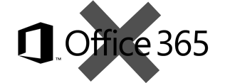
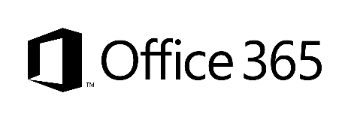
Redefining application models for SharePoint
Classic - Full trust solutions
ISV solutions
Platform level customizations to on-premises
Custom service applications
Custom WCF services
SharePoint customizations, not customer-specific customizations
Client Side Solutions
Server side controls as JavaScript on page layouts and master pages
Remote provisioning for elements
Embracing un-ghosted model
SP App dimension with provider-hosted apps to provide new capabilities
Customer-specific customizations
SP Apps
App catalog based solution
Packaged reusable solutions built for specific functionality
Not only for marketplace or store, but also as platform for customer-specific customizations
Notes:
Vesa
Time: 26:00

Slide 16

What do you really want to achieve?
Notes:
Steve
Time: 28:00

Slide 17
“But Apps is the pattern for cloud, not for my on premise…”
Really?
Notes:
Steve
Time: 29

Slide 18

What if…
We would use same model for on-premises and cloud?
Notes:
Steve
Time: 30:00

Slide 19
SharePoint App model
Forget full trust solutions
Embrace un-ghosted deployment models
Run the code outside of the SharePoint context
Much more than just App market place
Pattern is also valid for on-premises, not only for Office365
Notes:
Steve
Time: 31:00

Slide 20
Evergreen and release cycle – old model
SP2007
SP2010
SP2013
SP20XX
Upgrade
Upgrade
Upgrade
Upgrade
Specific upgrade project each time new version is introduced
Customizations have to be upgraded to get access on new capabilities in product
Will cause additional costs during each release cycle of customizations
Customization updates cause downtime each time something is changed
Complex ALM processes for ensuring quality of the code
Tightly coupled SharePoint customizations
Notes:
Vesa
Time: 33

Slide 21
Evergreen and release cycle – new model
SP2013
O16
O17
O18
Customizations will utilize services from SharePoint and other services, but won’t usually change out of the box services.
Development
Loosly coupled SharePoint customizations
You choose when and how applications are updated
Backwards compatibility for API level to move customizations cross versions
Customizations don’t block new capabilities from SharePoint
Customizations extend, not change SharePoint
Customizations can be updated with minimal impact on SharePoint
Notes:
Vesa
Time: 35

Slide 22

Denial is the first step…
Product roadmap is clear though…
Notes:
Steve
Time: 37

Slide 23

Remember when feature framework and solutions where introduced…
Notes:
Vesa:
Time: 38

Slide 24

Or when you were told that you’ll have to learn CAML…
Notes:
Steve Time: 39
Eray said we are sorry about that one ☺

Slide 25

SharePoint App Development
If you know general web development, you also know SharePoint development…
Notes:
Vesa
Time: 40
How many times have you had to work with Javascript/HTML devs to carve up their solution sot be SharePointy ?

Slide 26
“Will you ever support farm solutions in Office 365?”
No.
Farm solutions are deployed cross SharePoint farm and they’d impact multiple customers…
Notes:
Vesa:
Time: 42:00

Slide 27
“Will you introduce new model for app model replacement in near future?”
No.
App model solutions with remote APIs and control are here to stay
Notes:
Steve
Time: 44
NOTE: You may have seen our investments in Common Consent and O365 APIs, this should help you understand that we are investing in evolving this model going forward !!!

Slide 28
“I can’t do XYZ with app model?”
There are numerous things which might not be available as such with app model, but functional requirements can be achieved using alternative methods
Notes:
Vesa
Time: 45

Slide 29
Recommendations
Align with service and product roadmap
Avoid Sandbox solutions
Move gradually to app model
Concentrate on end users
Notes:
Vesa

Slide 30

Questions?

Slide 31

aka.ms/OfficeDevPnP
Transform your code
Providing App Model Patterns for common scenarios Open source and based on community contributions Constantly evolving set of material for reuse
100+ Visual Studio projects
Common scenarios Branding Site provisioning Remote event receivers
UX component Taxonomy driven navigation And much more…
Patterns and Practices Yammer Group - http://aka.ms/officedevpnpYammer

Slide 32


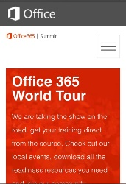
dev.office.com
Sign up
http://dev.office.com/getting-started
Explore
http://apisandbox.msdn.microsoft.com
Get trained http://dev.office.com/training

Slide 33


Feedback
Office 365 Network Share you best practices and join conversations
https://www.yammer.com/itpronetwork
Stackoverflow Ask deep technical questions to a world-wide set of developers
http://stackoverflow.com/questions/tagged/ms-office
UserVoice Provide suggestions of what you want in future versions
http://officespdev.uservoice.com/

Slide 34


© 2015 Microsoft Corporation. All rights reserved. Microsoft, Windows, and other product names are or may be registered trademarks and/or trademarks in the U.S. and/or other countries.
The information herein is for informational purposes only and represents the current view of Microsoft Corporation as of the date of this presentation. Because Microsoft must respond to changing market conditions, it should not be interpreted to be a commitment on the part of Microsoft, and Microsoft cannot guarantee the accuracy of any information provided after the date of this presentation. MICROSOFT MAKES NO WARRANTIES, EXPRESS, IMPLIED OR STATUTORY, AS TO THE INFORMATION IN THIS PRESENTATION.

